Slide 1
Success Stories SLNA Kerala

Slide 2
IWMP-II/2011-12 THIRUVANANTHAPURAM DISTRICT
PIA: CHIRAYINKEEZHU BLOCK PANCHAYAT

Slide 3
RENOVATION OF PERAPPAMANCODE CHECK DAM
Brief history
Perappamancode Check Dam is a concrete check dam with a wooden water regulatory valve system constructed in the Vamanapuram river basin.
It is located between 8°40’03.04N & 76°50’40.13E in the 4V29a microwatershed in Mudakkal Grama panchayat.
The unique feature of the check dam is that it was constructed by the British people during 1894 with the intention of keeping the perenniality of the downstream throughout the year; avoid flooding in the adjacent valley during harvest season of paddy and to provide controlled irrigation for the paddy crop.

Slide 4
Status at time of launching of IWMP
The iron bars used for fixing the wooden valve were totally ruined.
The wooden pieces of the Valve got damaged due to ageing and poor maintenance.
The concrete basement of the Valve System was broken here and there due to constant heavy flow of water over it.

Slide 5
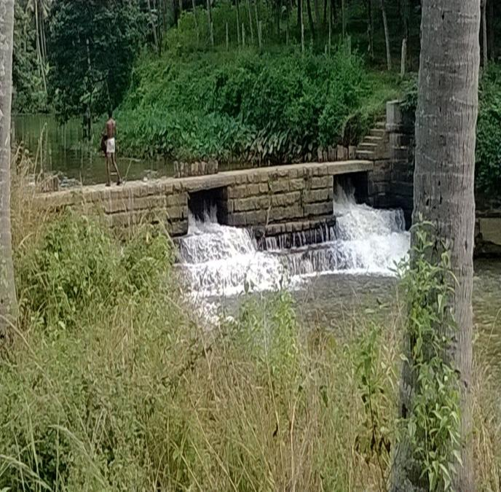
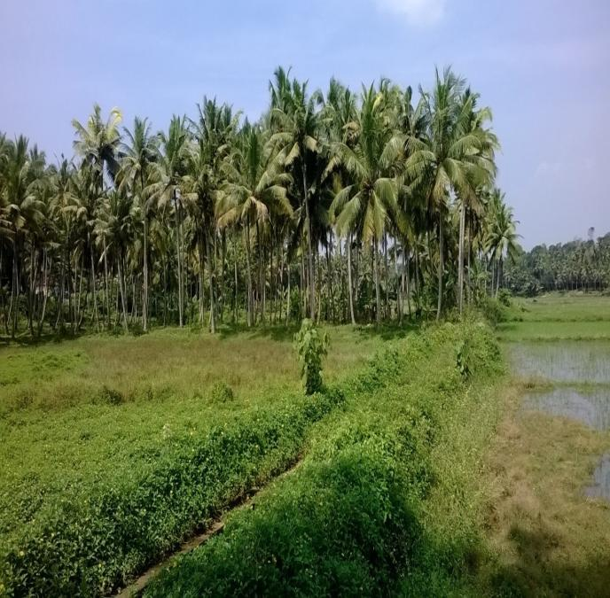
8°40’03.04N & 76°50’40.13E
Initial Status of the Check Dam and the Lead Channel

Slide 6
Interventions undertaken for renovation
Under PMKSY erstwhile IWMP
The damaged concrete construction was reinforced using steel and concrete;
broken wooden pieces were replaced by imported water friendly Pincoda wood from Malaysia.
The worn out cast-iron rod functioning as the base of the regulating valve system was replaced with a new one

Slide 7
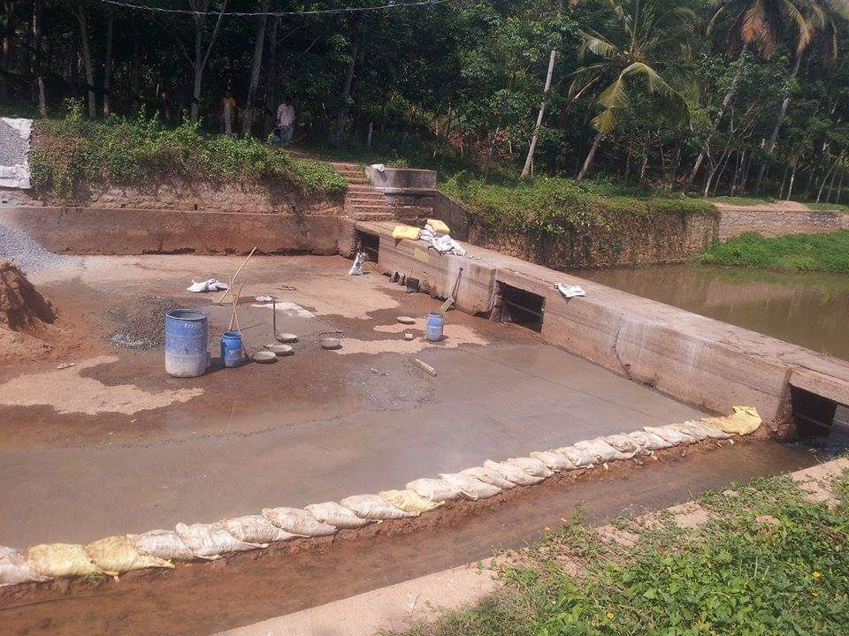
Work Under IWMP

Slide 8
B. Under convergence
Renovation of pump house and installation of pump set by Gramma panchayat
250m of lead channel cleared under MGNREGS

Slide 9
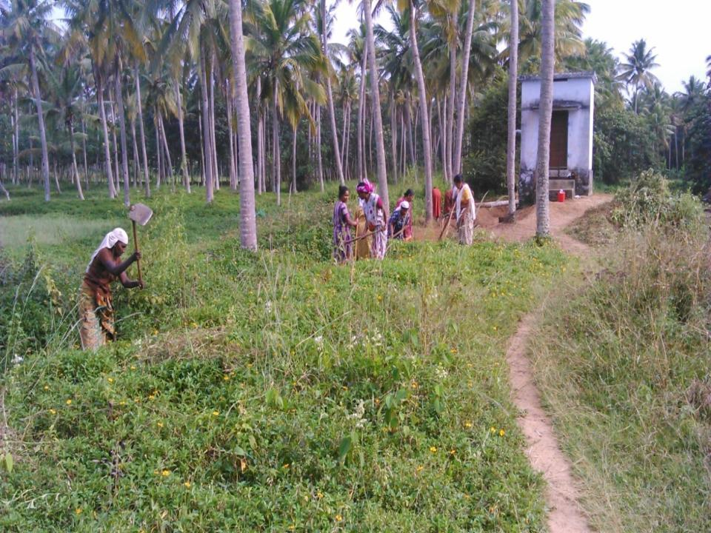
Site Clearance with MGNREGS Labourers

Slide 10
Financial Statement
IWMP Fund utilized Rs.1,82,445/-
Mudakkal GP’s contribution for Pump House and pump set – Rs. 1,50,000/-
MGNREGS contribution – 360 Person Days

Slide 11
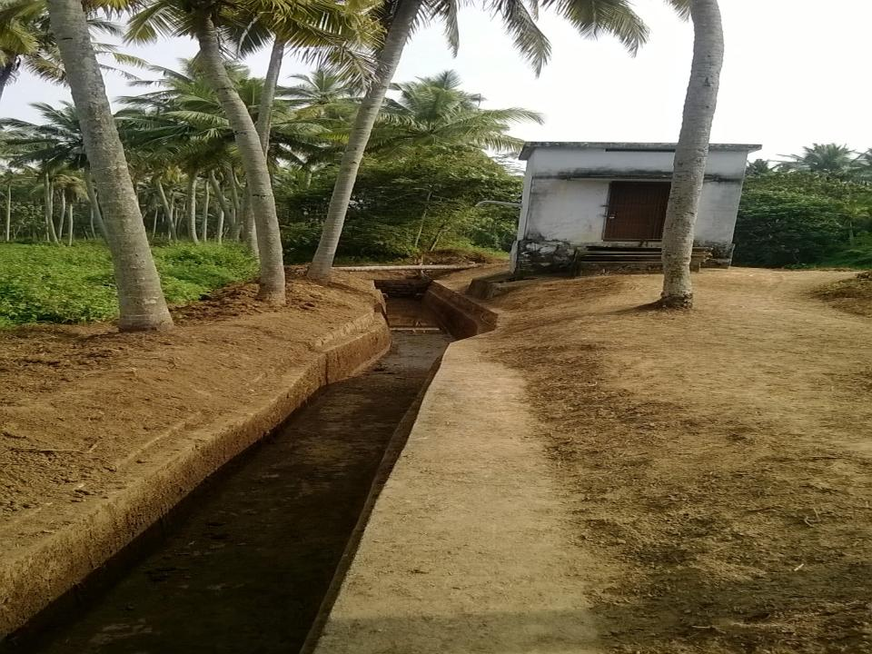
Pump House
After Completion

Slide 12
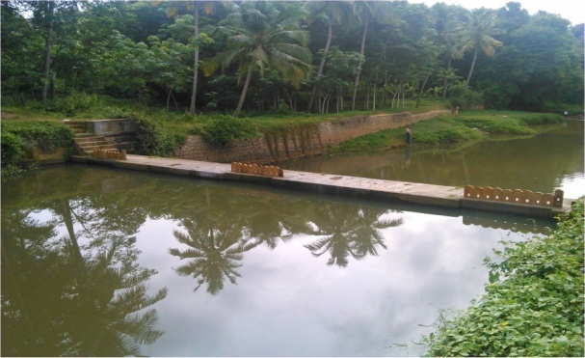
Wooden Plank
After Completion

Slide 13
Outcome of the Project
Water in the Check Dam is now utilized properly for the irrigation of 40 ha of nearby valley for crops like paddy, banana, vegetables, tapioca, yam etc.
The Check Dam functions as a water regulating mechanism to overcome the havocs of flood and drought.
It is also used for domestic purposes by the nearby inhabitants.
30 hectares of paddy cultivation has been resumed with the ardent support Mudakkal Gramapanchayat, farmers and JLG’s.

Slide 14
Contd..
50 JLG’s have been given monitory assistance under livelihood component by awarding seed money for paddy cultivation on leased paddy lands. This became a grand success and was convinced in person by the officials of the MoRD during their field visits.
All the JLG’s have repaid the seed money received by them within the stipulated time-limit and this shows that the endeavors were both physically and financially successful in all respects.
Improved the ground water level in the nearby wells which resolved the drinking water scarcity to a greater extent.

Slide 15
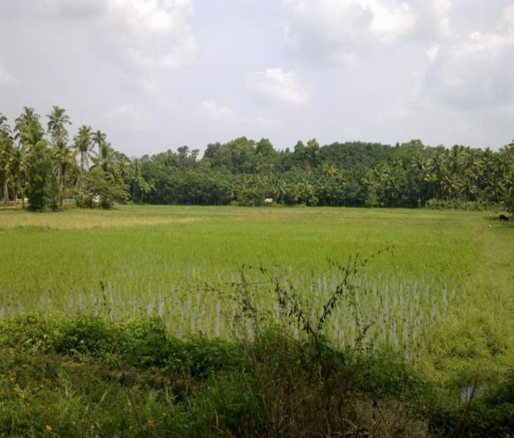
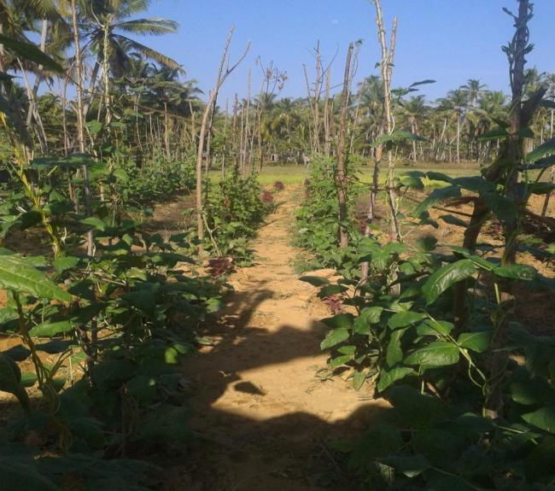

Slide 16
Renovation of Farm ponds and Rejuvenation of Culturable waste land
Ernakulam District

Slide 17
Details of The intervention
Name of the District : Ernakulam
Name of project : IWMP-2/2011-12
Name of PIA : Mulanthuruthy Block Panchayat
Name of Grama Panchayat : Chottanikkara, Ward 5
Watershed : Kunnathunad- Thalakode (13M19d)
Physiographic position : Midland

Slide 18
Status Before the Intervention
23ha of culturable waste land was left fallow for last 30 years
Reasons:
Improper drainage facility- 12 farm ponds and 2 water channels nearby were completely ignored . Due to siltation of the water bodies, the whole area was always flooded.
Unwillingness of the land owners for cultivation - as the C:B is low due to increased cost of cultivation
high labour costs
high fertilizer costs
high machinery expenses
Poor market price

Slide 19
Implementing Strategies
In 2016-17, the main thalakulam, Valiyakulam was desilted and renovated under PMKSY in convergence with Mahatma Gandhi NREGS

Slide 20
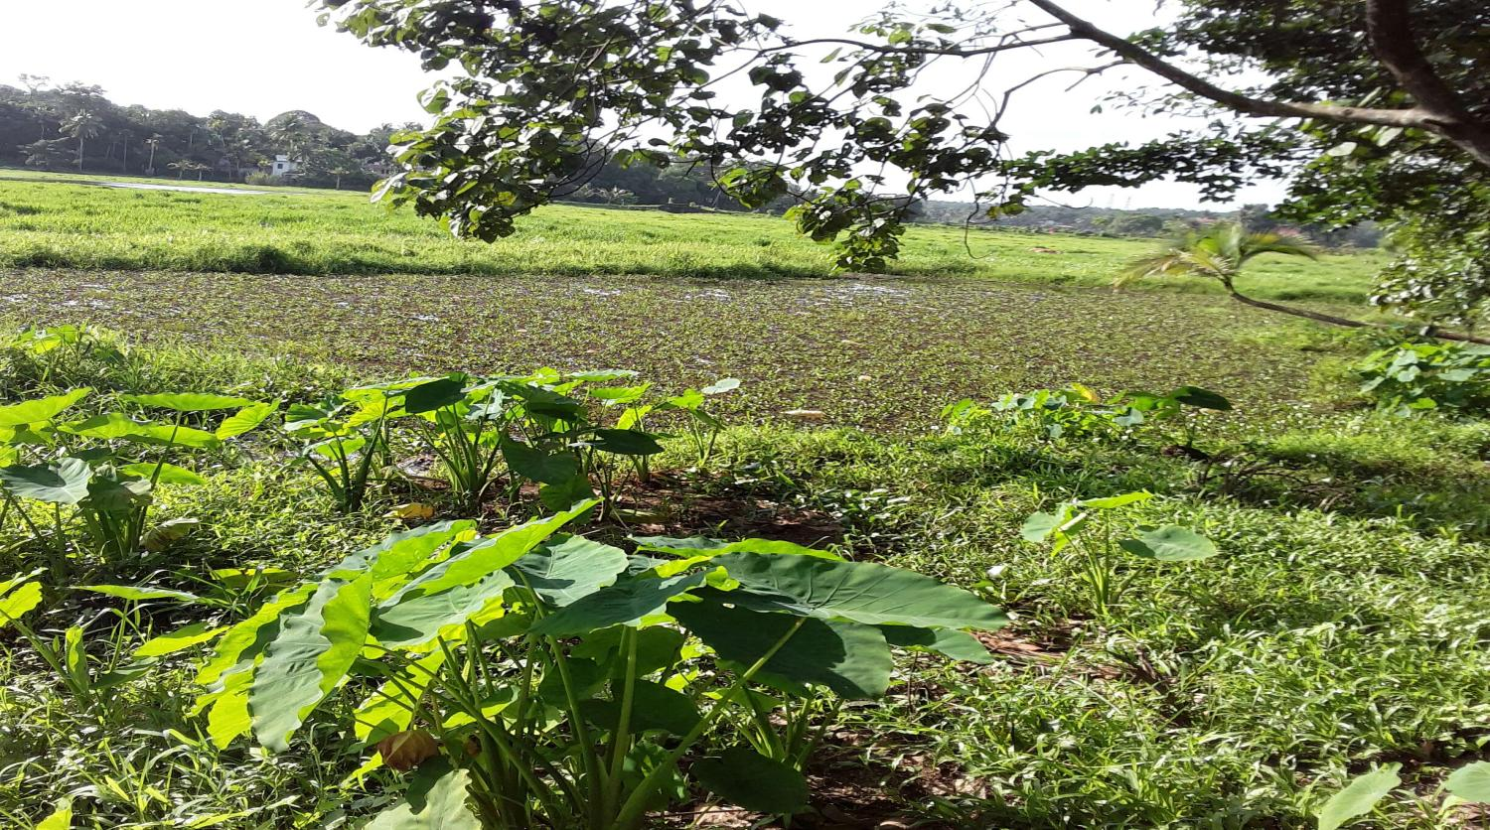
Valiyakulam Before

Slide 21
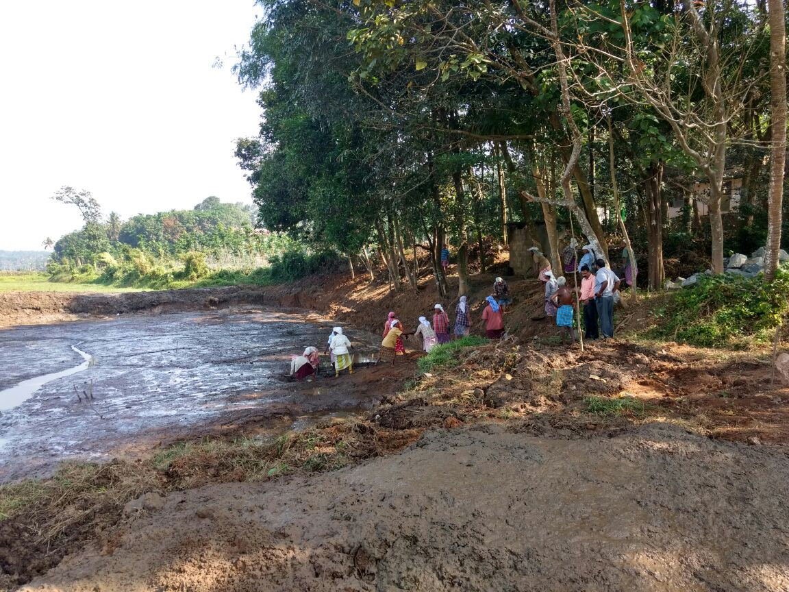
Desiltation of Valiyakulam in convergence with MGNREGS

Slide 22
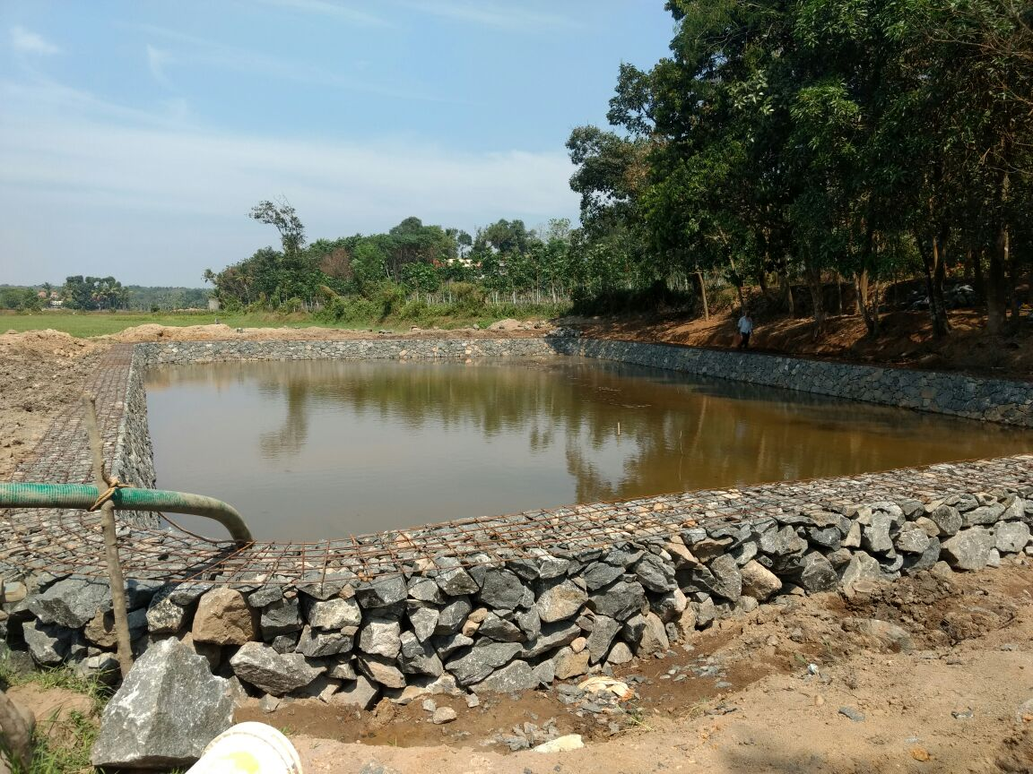
Valiyakulam work in progress

Slide 23
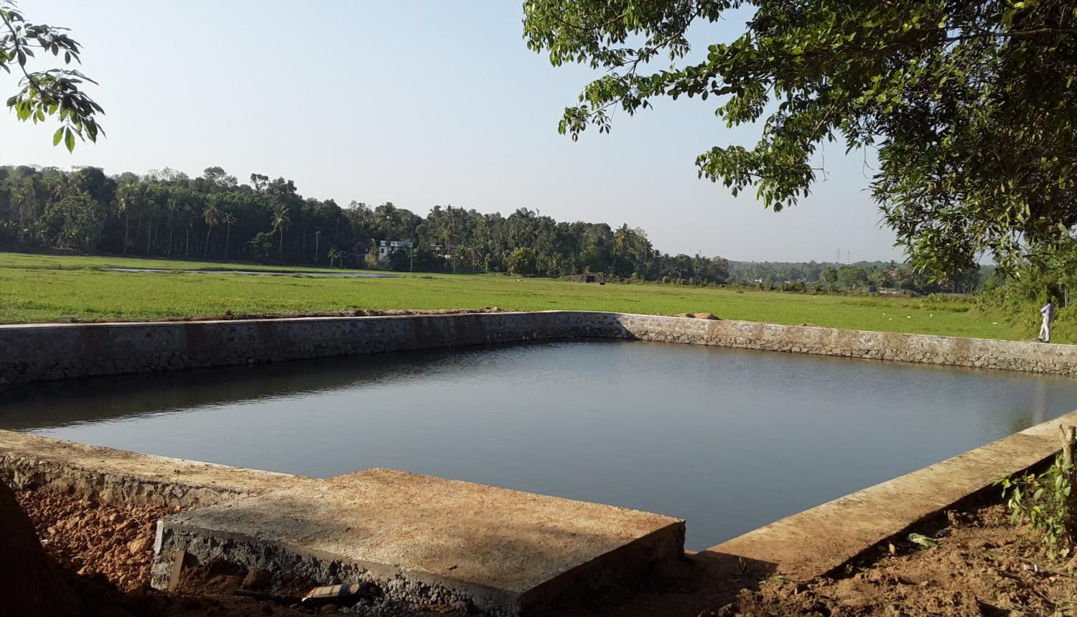
After Completion
PMKSY Expenditure -14,13,597
MGNREGS Expenditure-84500
Mandays -327
Capacity before -1000 m3
Capacity after -2000m3
9.929637, 76.396177

Slide 24
Padasekhara samiti constituted – 12 members
Meeting of concerned departmental officials, padasekhara samithi members, and elected representatives
Decisions taken- Desiltation and renovation of Ayyankuzhi chira of Ayyankuzhi Ayyappa temple (PMKSY)
Deepening and bund formation of Pallippuram puncha thodu (MGNREGS)
1 m height increase for Valiyakulam (PMKSY)
Subsidy for fallow land cultivation Agriculture Department and PMKSY
Request to Kshetra committee for surrendering Ayyankuzhi chira
20% revision of DPR and inclusion of above works

Slide 25
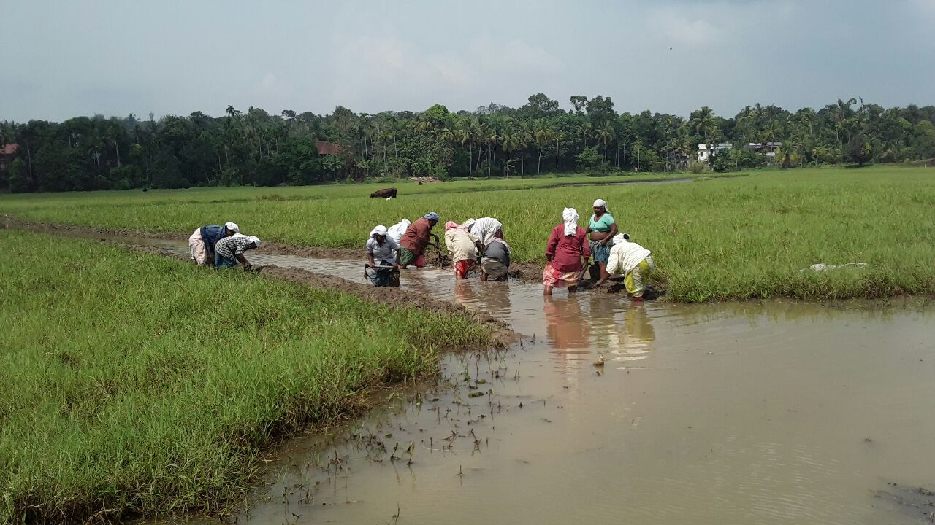
Desiltation of Pallippuram puncha thodu and bund formation under Mahatma Gandhi NREGS

Slide 26
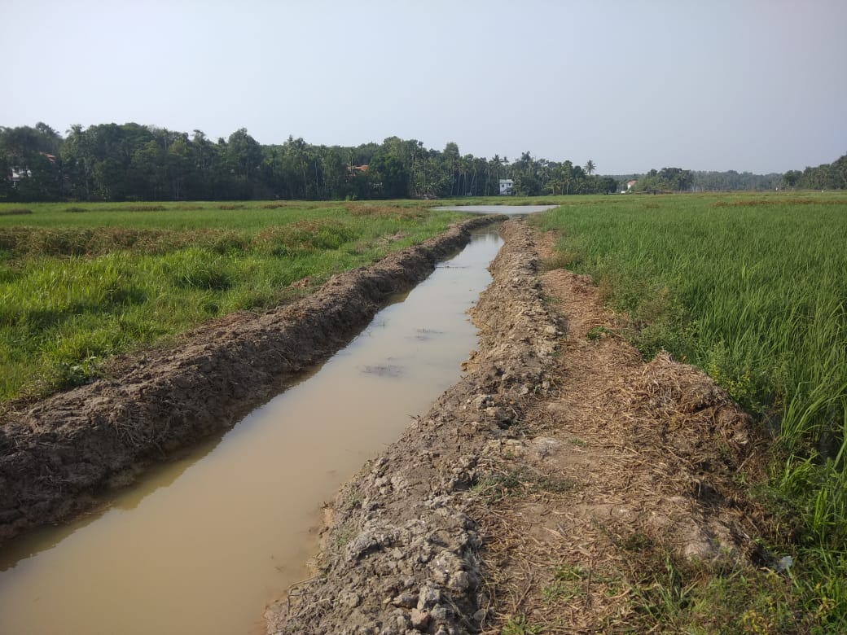
MGNREGS Expenditure-2,63,000
Length-1200 m

Slide 27
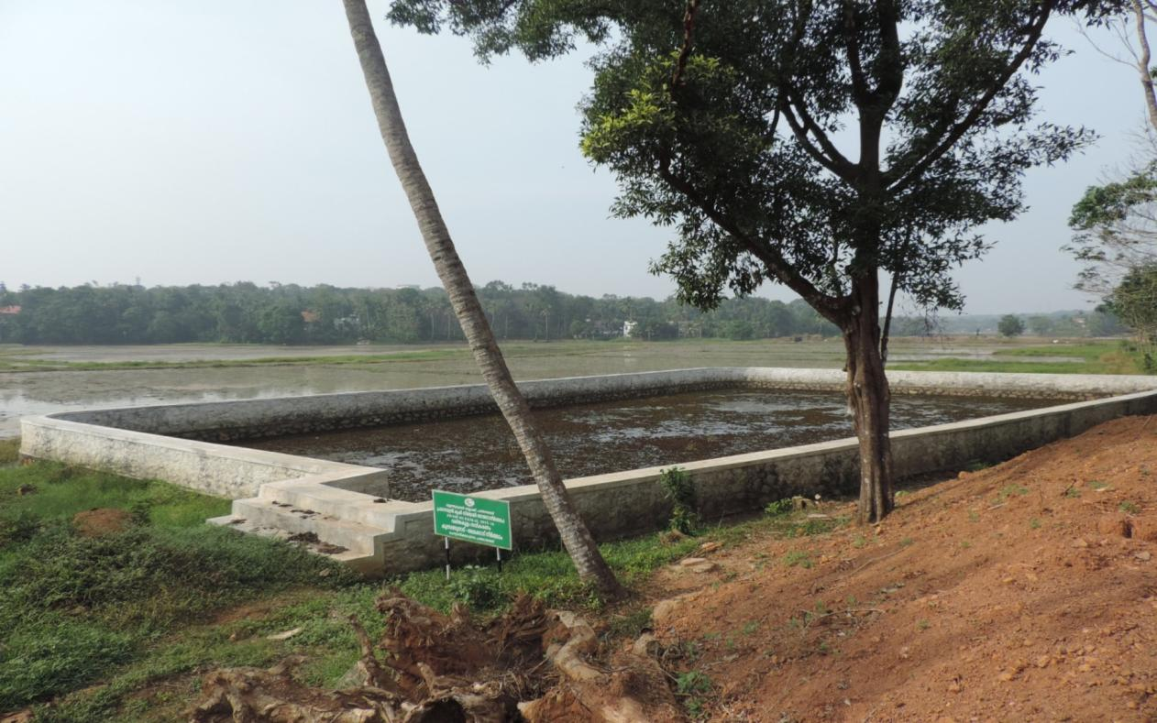
1 m height increased for Valiyakulam
PMKSY Expenditure -3,28,756

Slide 28
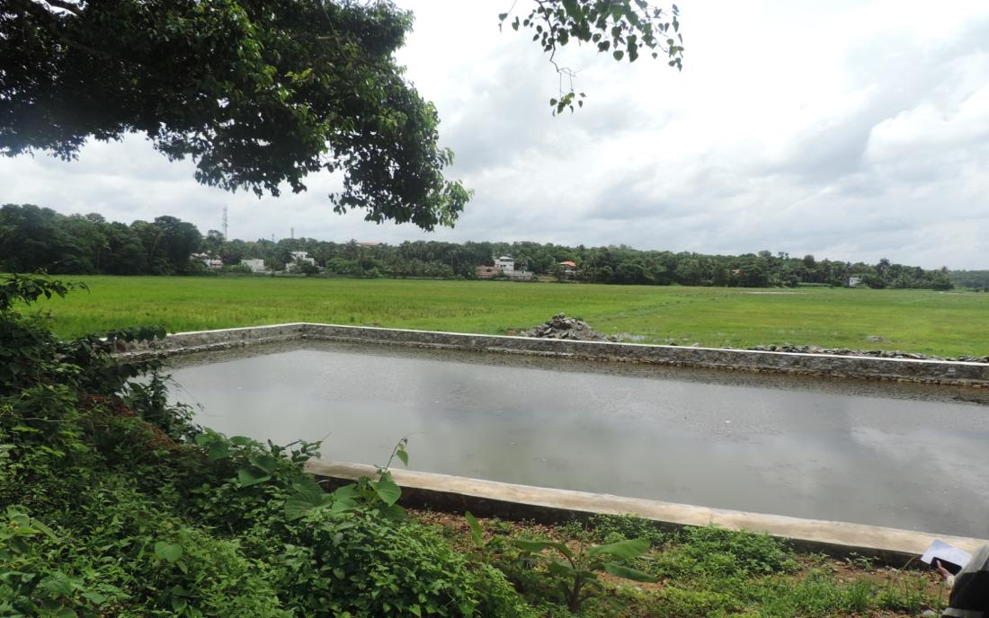
Desiltation and renovation of another main
thalakulam –Ayyankuzhichira under PMKSY

Slide 29
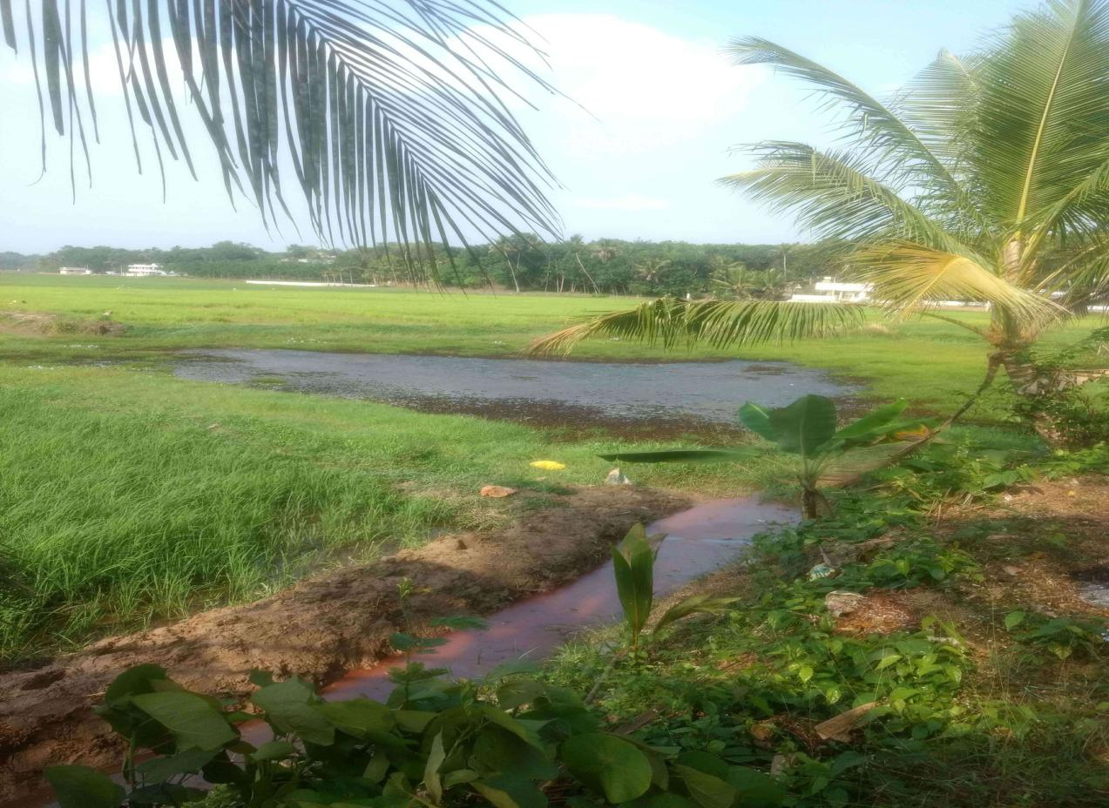
Ayyankuzhi chira Before

Slide 30
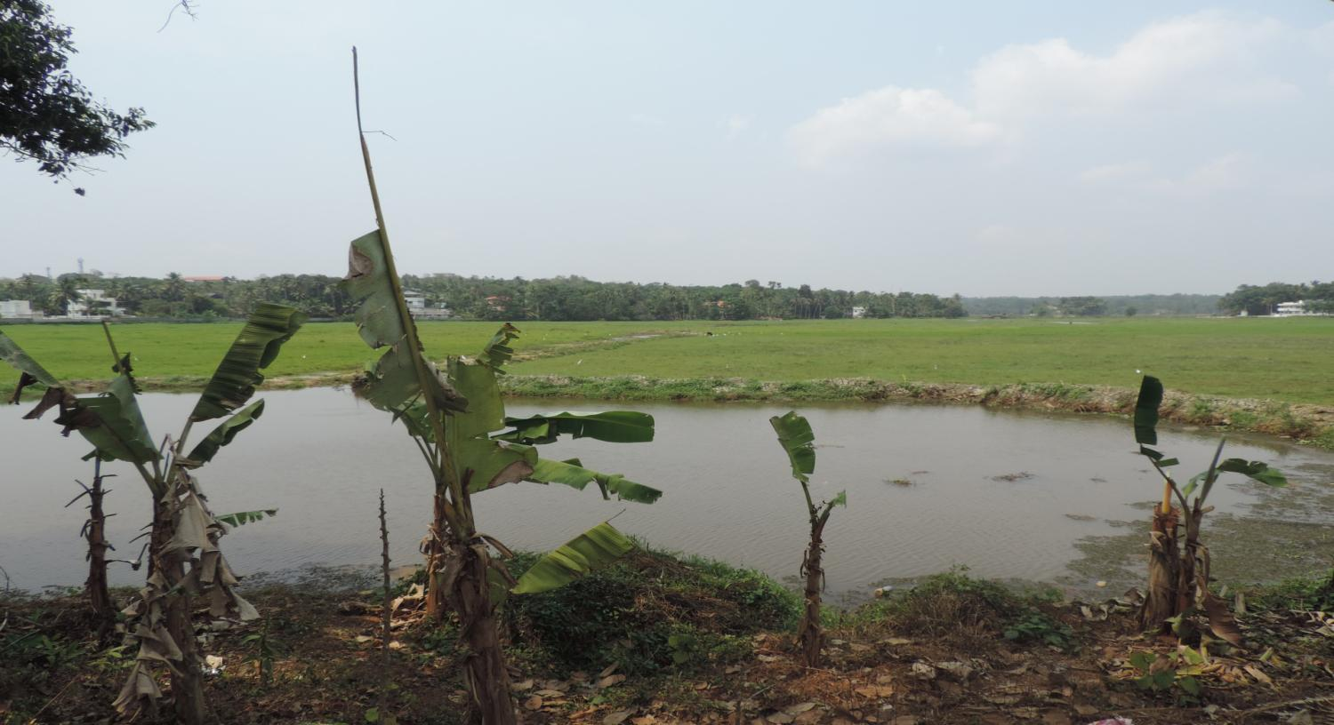
After Desiltation

Slide 31
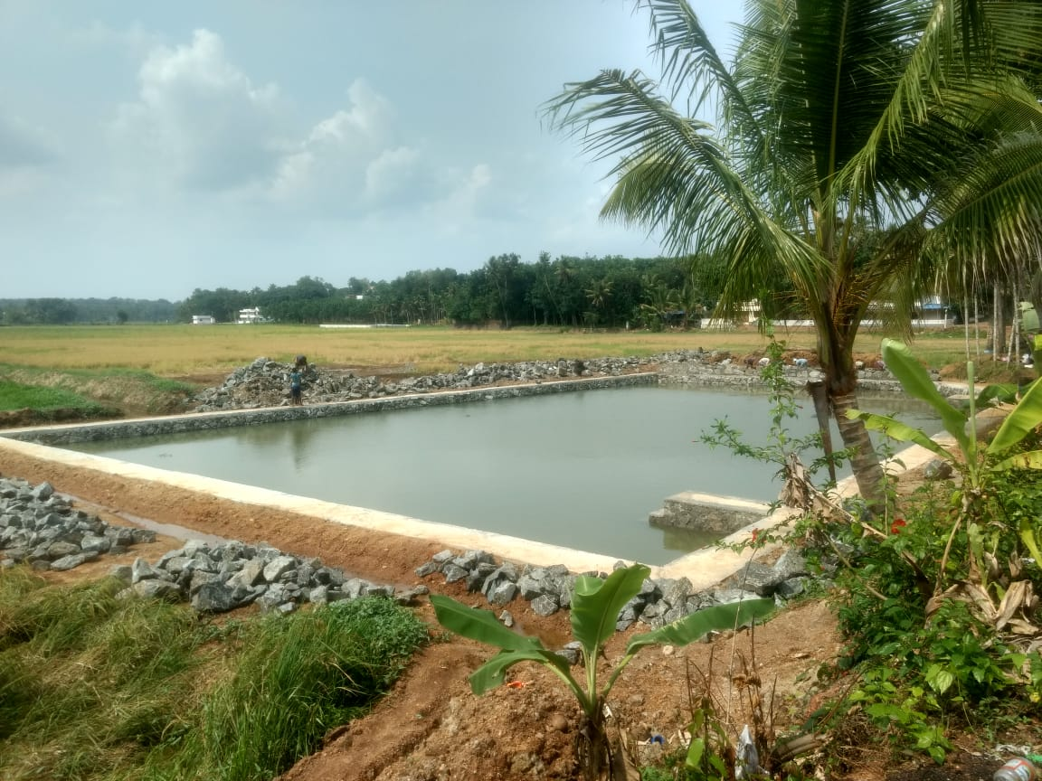
Work in progress

Slide 32
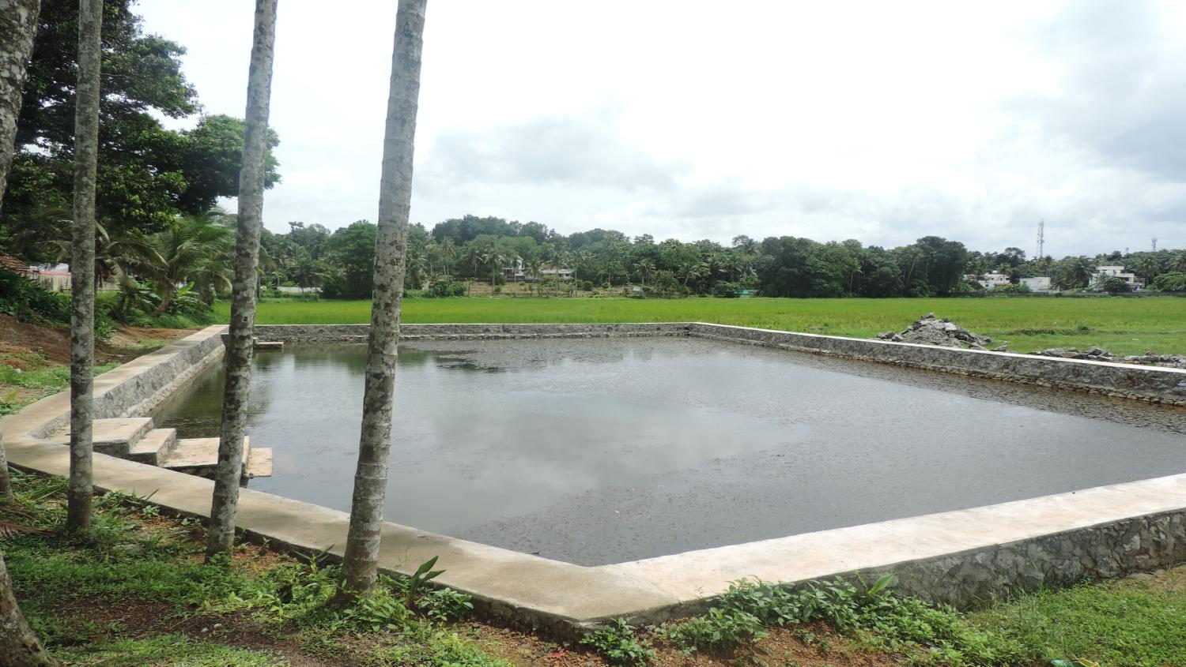
After completion
PMKSY Expenditure -14,52,000
MGNREGS Expenditure-84500
Capacity before -1000 m3
Capacity after -2100m3
9.9272568 N ,76.3947845 E

Slide 33
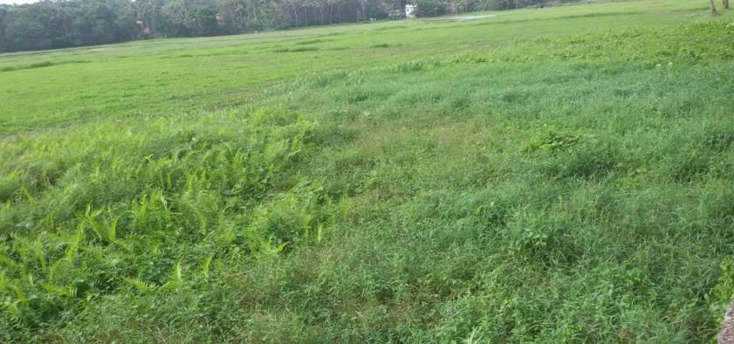
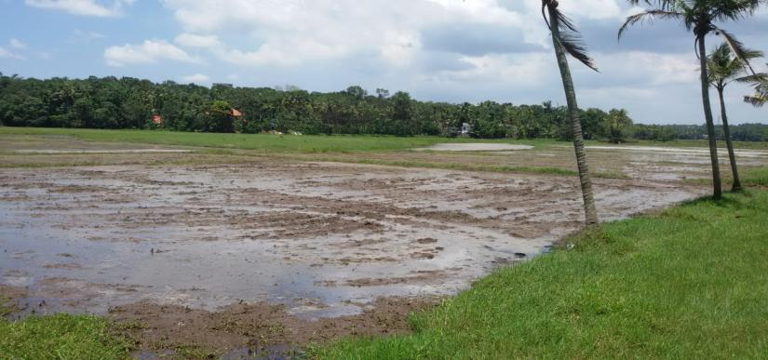
Land preparation by padasekhara samiti
Tremendous exercise – 3 times ploughed using tractor

Slide 34
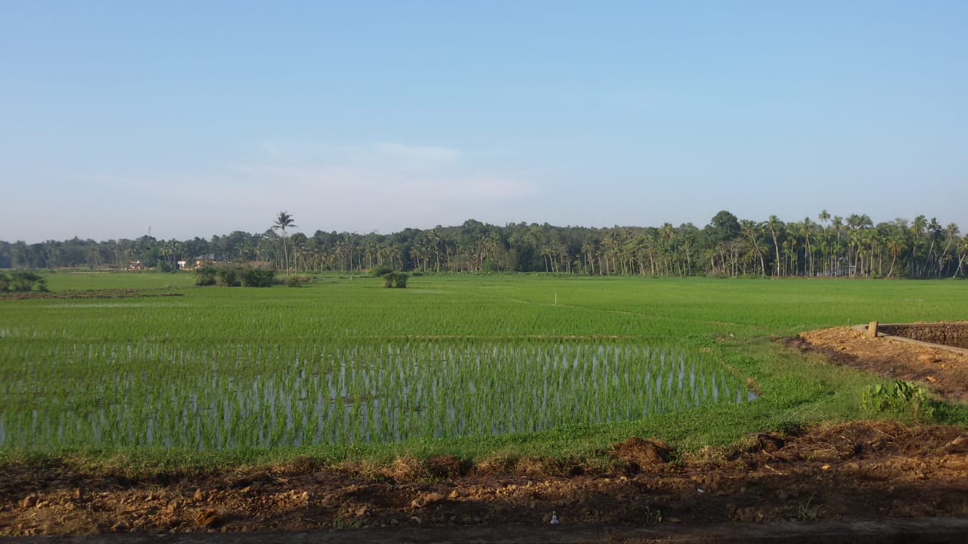
Pallippuram puncha field – different stages

Slide 35
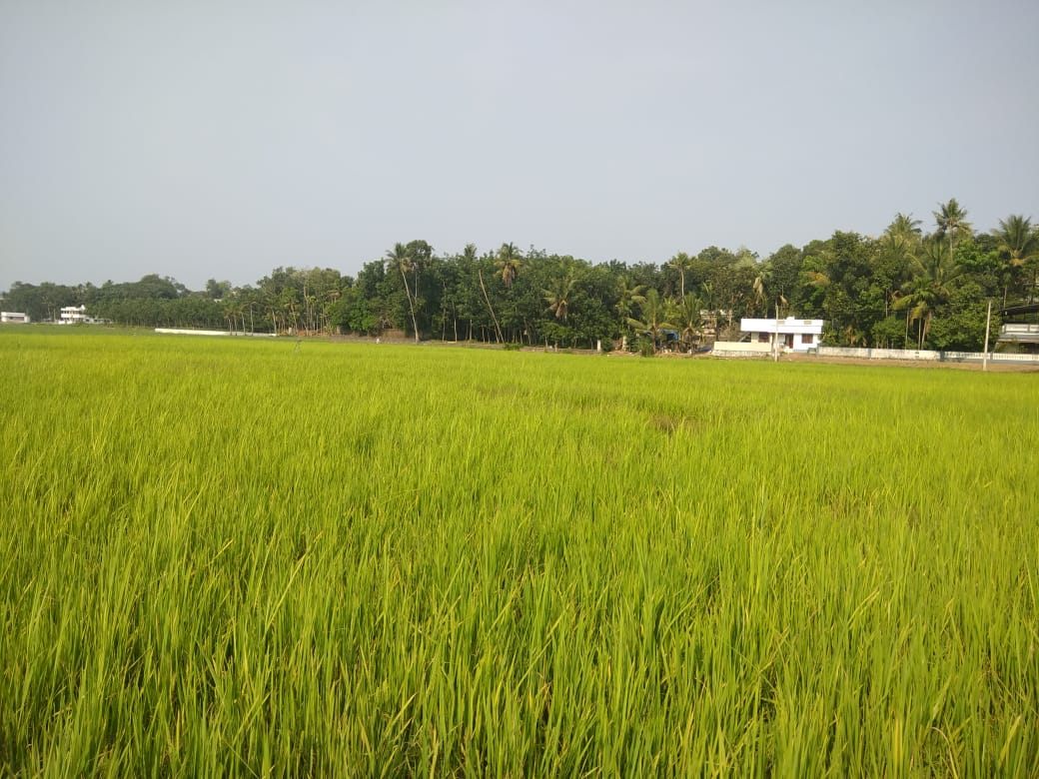
Pallippuram puncha field – different stages
9.928892, 76.395159

Slide 36
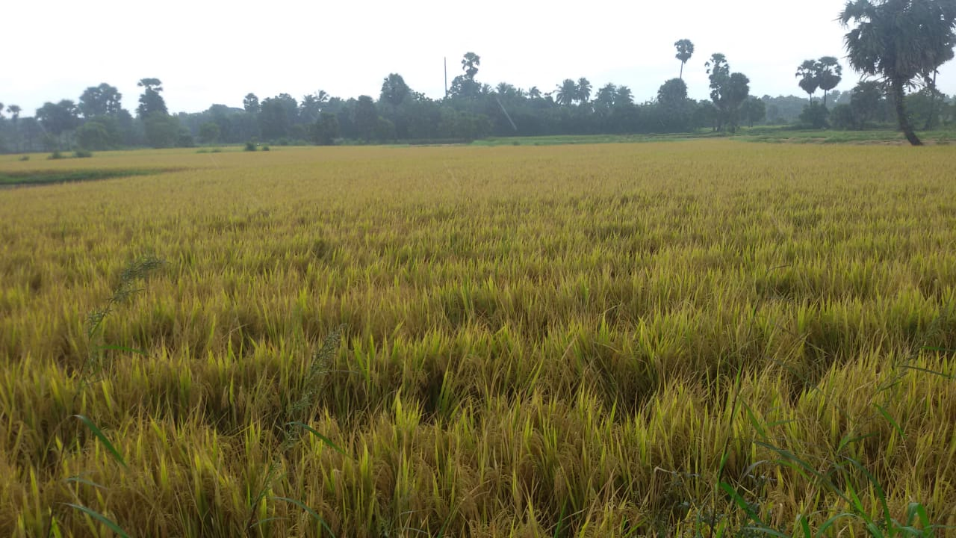
Pallippuram puncha field – different stages

Slide 37
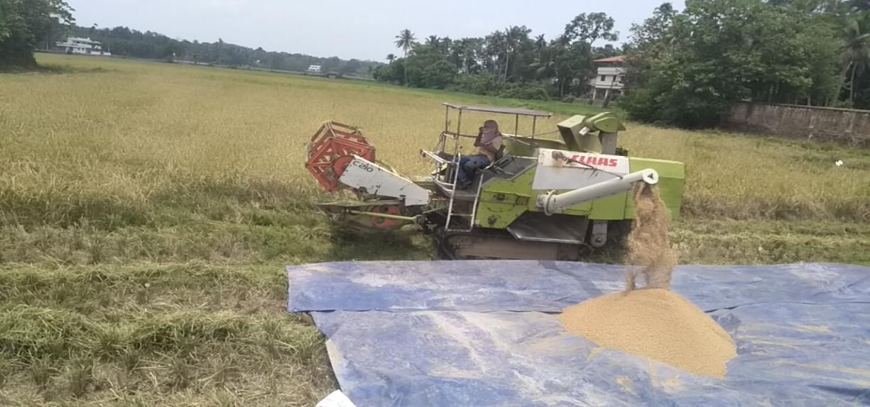
Subsidy released – Rs.48192 / ha
PMKSY – 4ha(land preparation, sowing, fertilizer application, field bund formation)
Agri Dept –for 8.5ha
12) Harvest Festival
Production -3-4ton/ha

Slide 38
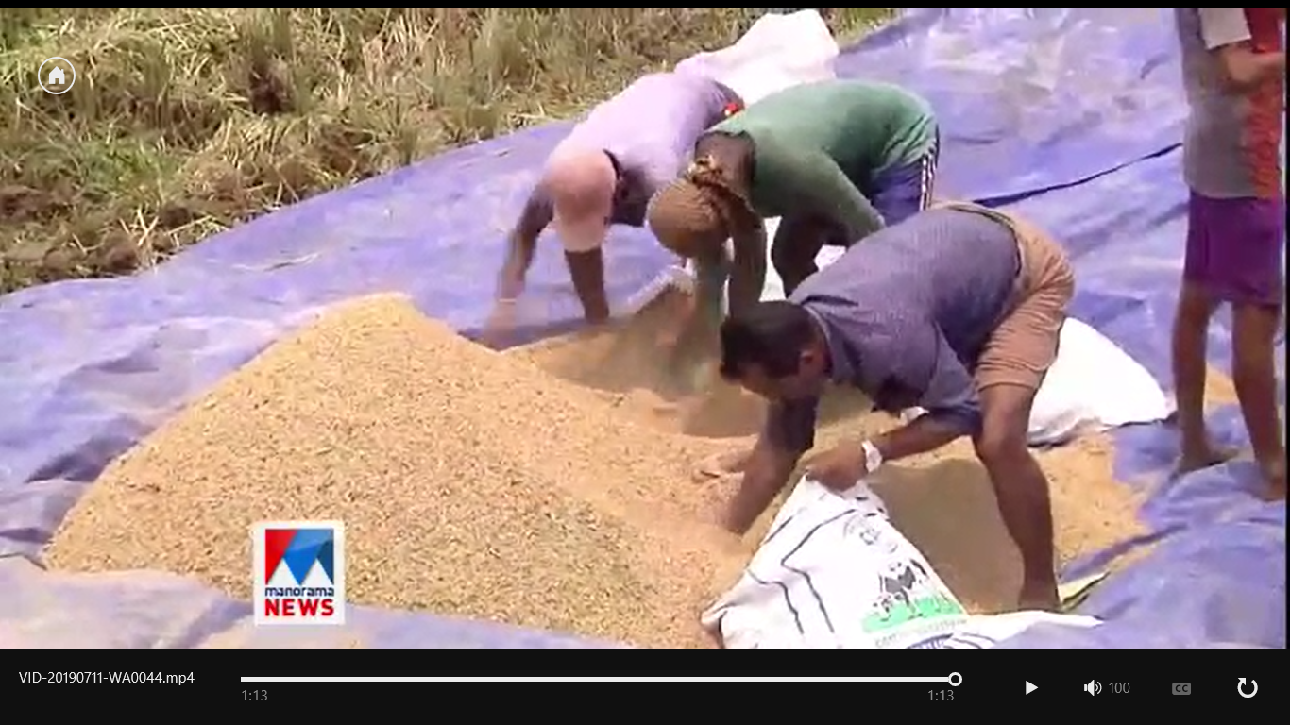

Slide 39
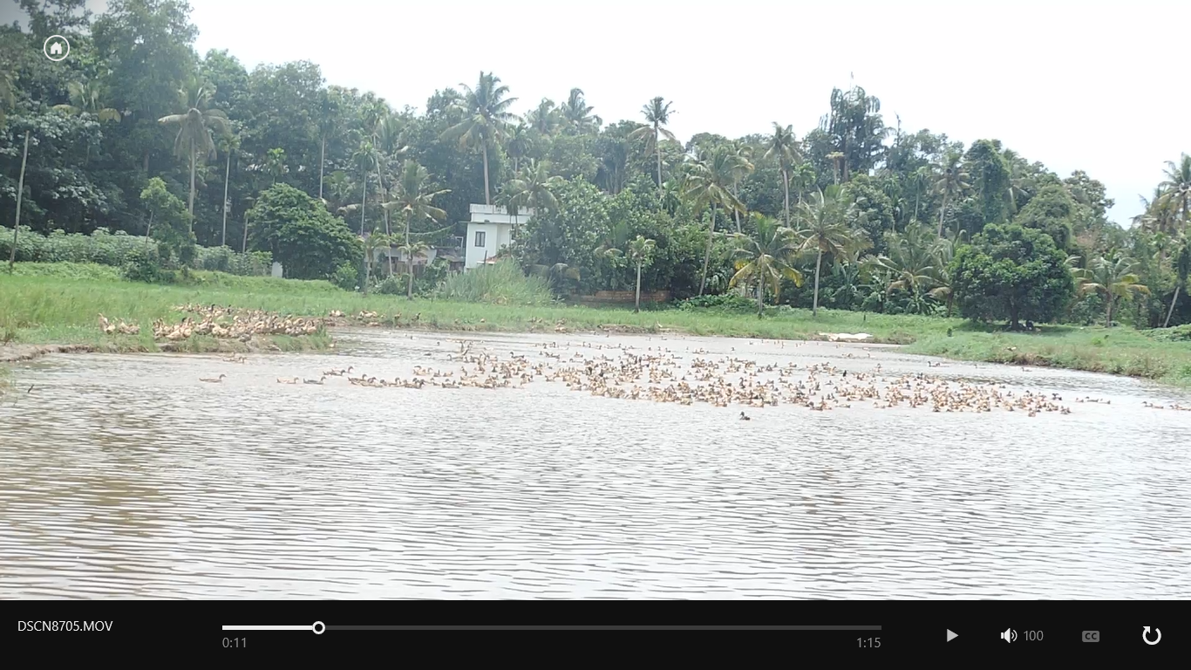
At present – Opened for duck & fish farming

Slide 40
Outcome
12.5ha of culturable waste land has been brought back to cultivation
Recharged the ground water of the nearby area profoundly
Improved the ecological balance of the area
Livelihood support to -12 families
Employment generation-965 mandays
Directly benefitted to -55 familes
Addressed food security

Slide 41
